Slide 1
Renewable Energy in Kentucky
Possibilities and Policies
Notes:
Note: each * indicates when you should hit <enter> on the computer to move to the next slide or section of a slide
As the nation turns towards clean energy, it's not too late for Kentucky to be at the forefront of this movement and to attract millions of dollars in investments that will create clean energy jobs.
In order for that to happen, we need to put clean energy policies in place that will attract good energy investments and grow our state clean energy market.
Working class families in Kentucky are struggling with lost jobs and drained pocketbooks from the recession and from our tough state economic climate. They're looking for the money saved and the jobs created that clean energy policies will bring. *

Slide 2
Kentuckians use a lot of energy and bills are rising!
KY homes use 1,150 kilowatt-hours of electricity per month
Half of Kentucky’s 89,000 GW-hour annual usage is industrial
Energy bills have risen 41% over the last 5 years and are expected to rise at least 25% more by 2015
Notes:
We use a lot of energy in KY—an average of XX kilowatt-hours of electricity per month. That’s an interesting number, but what exactly is a kilowatt and a kilowatt-hour?
One kilowatt is equal to 1,000 watts. Generally, a 60 watt light bulb pulls a constant 60 watts of electricity when it is turned on.
A kilowatt-hour is the amount of kilowatts—1,000 watts—used in an hour. Using a 60 watt light bulb for one thousand hours consumes 60 kilowatt-hours of electricity.
The capacity of a power plant is usually measured in Megawatts or Gigawatts. A Megawatt is 1000 kilowatts (KW). A gigawatt (GW) is 1000 MW. *
Half of our annual usage in KY is used by industry. *
Energy bills have increased rapidly in the past 5 years and are projected to continue to rise. *

Slide 3

It is time for Kentucky to transition to clean, affordable and sustainable energy solutions
Create local jobs and grow Kentucky’s economy
Save money for Kentucky’s families, farms and businesses
Improve Kentuckians’ health and environment
Build on Kentucky’s clean energy momentum
Notes:
It is time for KY to transition to clean, affordable, and sustainable energy solutions. What will we gain? *
We will be able to create more local jobs and grow KY’s economy. *
We’ll save money for KY’s families, farms, and businesses. *
We’ll improve Kentuckians’ health and our environment. *
And we’ll be able to build on the clean energy momentum that is building even as we speak .*

Slide 4
Kentucky’s Clean Energy Potential
    Energy Efficiency
    Hydropower
    Solar
    Wind Energy
    Biomass
Notes:
We’re going to briefly run through each type of clean, sustainable energy that we think has potential for Kentucky. We aren’t renewable energy experts, but we’ll give you some basic information about each.
We’ll cover -
-what it is
-what is the potential
-what are the benefits
After we’ve done that, we’re going to spend a few minutes reviewing what Kentucky is doing well in terms of sustainable energy and what stands in the way of us having more of it .

Slide 5
How do we evaluate what is feasible?
Local Expertise & Workforce
Technology
Access to Capital
Siting Issues
Public Policy
Transmission
Uncertainty
Notes:
There are at least three key factors to consider when trying to assess the potential for EE and RE in Kentucky. The first is what’s the actual amount of the resource in Kentucky. How many south-facing rooftops do we have? How many acres of land with decent wind speeds? How many existing dams suitable for hydro? How many poorly insulated manufactured homes are there?
Another question to consider is what percentage of the time could we expect a renewable system to operate, based on what we know of local weather patterns? This is often referred to as the technology’s “capacity factor.”
Finally, we would want to evaluate the total lifetime costs of a renewable system – including installation, maintenance and operations, and fuel – relative to those same costs for new coal, gas or nuclear plants. (Or, for a customer installed renewable system, we would want to evaluate the lifetime costs relative to the expected retail price of electricity.)
And in reality, things get even more complicated. The equation is also influenced by things like:
changing technology,
how easy or hard it is to get access to loans to build new systems,
whether or not there are good transmission lines from the places where the renewable resources are best,
whether or not we have a trained workforce,
how easy or hard it is to get access to specific sites (whether those are dams on a river or land on windy hilltop),
and how much uncertainty there is around things like future costs, future regulations, future demand.
Lastly, public policy at the local, state and national levels greatly improve or limit the potential for renewable energy and energy efficiency in Kentucky. All of these equations change if, for example, there is a price on the cost of carbon dioxide emissions. Or if Kentucky offered a guaranteed price to developers of renewable energy in our state. Or if our utilities were required to get an increasing share of their electricity from renewables and efficiency.

Slide 6
Energy Efficiency
Kentucky’s Clean Energy Potential
Notes:
First, we’ll look at Energy Efficiency. *

Slide 7

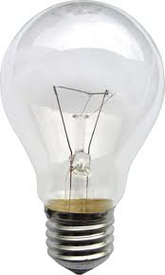
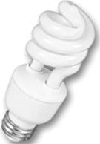
What Is Energy Efficiency?
Transitioning to renewable energy begins
with improved energy efficiency
Notes:
Energy efficiency is anything and everything we do to make more efficient use of the energy we consume—insulating our homes and businesses, buying Energy Star appliances, installing double-paned windows, sealing leaks around doors and windows, switching from incandescent bulbs to “curly” ones, turning off the lights when we leave a room, making sure that the tires in our vehicles are inflated to the proper pressure, driving at slower speeds (55mph is the most fuel efficient speed for driving), planning your errands so that you don’t have to backtrack—you get the idea. *

Slide 8
What do we know about KY’s
Energy Efficiency potential?
“Improved energy efficiency could meet all of the growth in [Kentucky’s] energy demand predicted by 2017.”
Over 10 years, cumulative energy savings would be equivalent to power from three 500 Megawatt power plants
A recent study showed that with significant efficiency investments, Kentucky could:
  Cut residential energy costs by $240/yr on average
  Save retail establishments $18,000/yr on average
Notes:
The potential for savings is enormous. *
We know that we’re using more energy per person every day, but if we put a strong program of energy efficiency in place, we could save an amount equal to the amount of the projected increase. ( Kentucky Pollution Prevention Center) *
We could eliminate the need for another new power plant that would have provided all that extra energy. *
We could cut average power bills for homes and businesses alike. *

Slide 9

Energy Efficiency Saves
Money and Energy
Drucilla’s Story:
  New windows, doors & insulation, Energy Star appliances
  Even with loan payment, monthly expenses are lower
  Improved quality of life
Notes:
Here’s an example of how energy efficiency measures can help. *
Frontier Housing, a member of the Kentucky Sustainable Energy Alliance, helped Drucilla, an elderly Rowan County woman living on a fixed income, to rehab her drafty, inefficient home. *
Through a low-interest loan, Drucilla’s house received a full slate of weatherization and efficiency repairs. *
Now, Drucilla lives comfortably and, even with her loan repayment, is saving on her monthly bills due to her drastically decreased utility costs. *
But not only does weatherization help the homeowner, it creates good jobs for construction workers—jobs that can’t be outsourced.
Two winters ago the Pine Mountain Settlement School received a grant to rehab some homes in Harlan County. At one manufactured home, the family reported that their electricity bill was $500 in January before the rehab was done and then $100 in February after the work was completed. The potential is great! *

Slide 10
Energy Efficiency Investments Create Jobs
The 2010 report by the Southeast Energy Efficiency Alliance found that by 2020, energy efficiency could
  Reduce energy bills by $41 billion
  Moderate electricity rate increases
  Create 380,000 new jobs
  Grow the region’s economy by $1.23 billion
Notes:
A 2010 report found that by 2020 energy efficiency (source: Southeast Energy Efficiency Alliance) could *
Reduce energy bills by $41 billion (that’s billion with a B) *
Keep electricity bills from climbing at the high rate that we’re currently seeing *
Create 380,000 new jobs *
Grow the economy in the southeast US by $1.23 billion (that’s billion with a B)
A newer study shows that upgrading just 40% of buildings in US would:
Create 625,000 jobs nationwide and
Save ratepayers $64 billion per year in utility costs! (source: http://www.americanprogress.org/issues/2010/08/pdf/good_jobs_new_markets.pdf)
Every $1 million invested in energy efficiency has the potential to create 10 construction jobs and 3-4 manufacturing jobs (source: Apollo Alliance) *

Slide 11
Hydroelectric Power
Kentucky’s Clean Energy Potential
Notes:
Now let’s look at Hydroelectric Power

Slide 12

What is Hydroelectric Power?
Mother Ann Lee Hydro plant on the Kentucky River
near Harrodsburg
Notes:
Hydropower is exactly what is sounds like – it’s using flowing water to power at a large dam or through a small turbine on a creek for example, to create electricity. If done right, is clean energy with little environmental impact. Adding hydropower at existing dams usually has almost no harmful environmental impacts. One of the recent projects which has been a great success is the Mother Ann Lee restoration on the Kentucky River., which you can see above. There’s also great opportunity for small hydro projects – powering a home or neighborhood through use of flow from creeks and even run off from MTR sites in Eky.

Slide 13
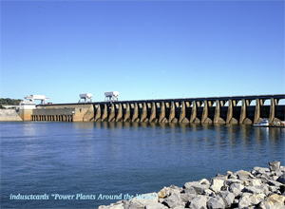
What do we know about KY’s hydro-power potential?
Adding this would more than double KY's current hydro generation!
887 Megawatts potential
at existing dams
Notes:
KY has significant untapped potential to generate electricity from water flowing over existing dams in KY. The National Laboratories in Idaho (a US agency) looked at potential hydro-electric sites in KY in 2003 and concluded that we could generate 887 mega-watts of power at existing dams. Current cost estimates show these sites could be developed for less than the cost an equivalent power plant. Doing so would more than double Kentucky’s current hydro-electric generation (2.6 times the current level).
And, there may be potential for us to generate power and create jobs through manufacturing and using micro hydro turbines, which are currently only available outside the US.

Slide 14

Lynch Hydro Plan
Using outflow from sewage treatment plant as hydro power
14 MW potential
Notes:
The community of Lynch has developed an interesting grant application for a small hydropower project using the constant water outflow from their sewage treatment plant which drops 70 feet to the river below. This is something that could be replicated in other communities.

Slide 15
Solar Power
Kentucky’s Clean Energy Potential
Notes:
And now, on to Solar Power *

Slide 16
What Is Solar Power?
Three Types:
Solar Thermal
Solar Photovoltaic (“PV”)
Concentrating Solar
Notes:
There are three categories—or types—of Solar power *
Solar Thermal installations use the sun to heat a liquid (usually water) that then transfers the heat to a water heater or a heating system. This is a mature, well-developed technology and can easily be designed to work in times of power outages. These installations are less expensive than other solar installations, and the costs have basically leveled out. Commercial users are finally starting to take note – residential care facilities, restaurants, car washes, etc. *
The second type of solar power is Solar Photovoltaic (or PV). These installations create electricity that can be used to power a home or business or that can be sent to the power grid to provide power for others’ use. The up-front cost of a PV installation is high but is dropping steadily. And once the equipment is paid for, there are no fuel costs to pay, unlike power plants fueled by coal, natural gas, or nuclear energy.
THESE FIRST TWO ARE GOOD IN KENTUCKY for small, “distributed generation” systems—small systems on homes and businesses that are “distributed” over an area, rather than the large power plants that are centralized in one place. *
The last type of solar power is Concentrating Solar, which is what most policy makers are thinking about when they talk about solar power. These are typically large solar farms—utility scale solar. These are best suited for the southwest United States and would not really be useful in Kentucky. *

Slide 17
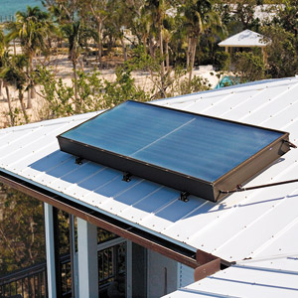
What do we know about solar hot water potential in KY?
A solar hot water system can provide 50-80% of a household’s annual water heating needs
A system can pay for itself in 5-9 years at today’s energy prices in Kentucky
Notes:
Kentucky’s climate is well suited for solar hot water systems. Solar hot water systems are cost effective at today’s energy prices, meaning that they can pay for themselves in a reasonable amount of time. A recent study showed that putting solar hot water heaters on 20% of new homes in Kentucky would create 840 new installer jobs. *

Slide 18
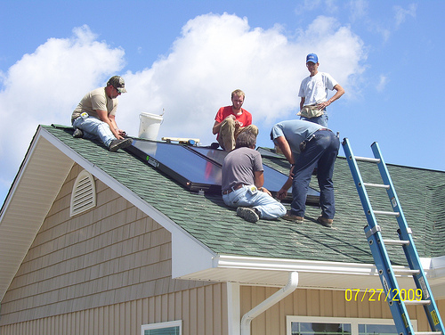
What can we say about solar PV potential in KY?
Kentucky’s solar resources are better than Germany’s, which has the greatest amount of installed solar capacity in the world
Residential PV installation in Lewis County KY
Notes:
What can we say about the potential for solar PhotoVoltaic production in KY? *
Kentucky’s solar resources are better than Germany’s, which has the greatest amount of installed solar capacity in the world. And they didn’t do it with big solar farms. 80% of the solar electricity in Germany is generated by panels on the rooftops of homes and businesses
When combined with an energy efficient home, rooftop PV solar panels can provide most or all of the annual electricity needs for a home in KY.
The Governor’s energy plan of 2008 estimates that rooftop solar could provide 1% of Kentucky’s energy demand by 2025. Nationally, however, reports have shown that rooftop solar PV panels could provide as much as 7% of the nation’s energy use by 2030. Kentucky clearly has the solar resources to achieve that level of production. What we lack is the vision and political will to make it a priority. (Source for the 7% figure: Tackling Climate Change, Kutscher, editor, 2007, available at www.ases.org) *

Slide 19

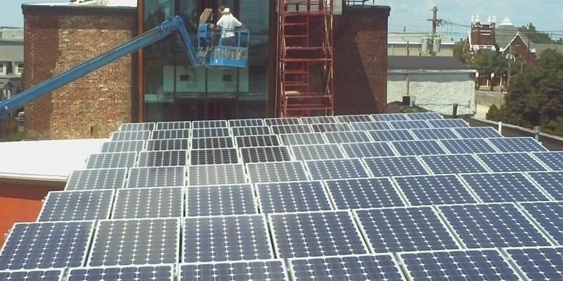
The Green Building in Louisville
Commercial PV Installation
Notes:
These are pictures of a 17 kilowatt PV array on top of the Green Building in Louisville. *

Slide 20
Solar Energy Investments
Create Jobs!
1 MW capacity installed = 20 manufacturing jobs and 13 installation/maintenance jobs
Solar employs over 50,000 in Germany, expected to be 100,000 by 2012
Tennessee: 1000 solar jobs
Ohio: 1500 solar jobs
Notes:
And in these days of high unemployment it’s important to note that solar energy investments create jobs! *
For every megaWatt of energy production that’s installed, 20 manufacturing jobs and 13 installation and maintenance jobs are created (Source: George Ban-Weiss et al., Solar Energy Job Creation in California, University of California at Berkeley) *
Germany already has created over 50,000 jobs as a result of their push for solar, and even more jobs will be created by 2012 (Source: Apollo Alliance) *
TN’s solar program has created over 1000 new jobs, with more on the way as new solar manufacturing facilities are being built. *
Ohio has created 1500 solar jobs.
And in Kentucky, Alternative Energies KY in Danville is making solar panels, Dow Corning is making the special glass for solar panels, and Kentucky residents living north of Nashville are commuting to Clarksville TN to work in a solar manufacturing plant there. In addition there are a number of small firms in Kentucky who design and install solar systems. *

Slide 21
Wind Power
Kentucky’s Clean Energy Potential
Notes:
What about Wind Power?

Slide 22
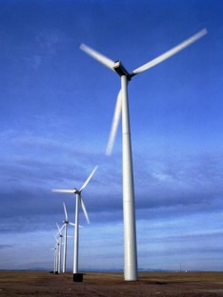
What is Wind Power?
Small Scale Potential
Large (Utility) Scale Potential
Notes:
There are two main types of wind potential feasible in Kentucky – small and large scale.
SMALL-SCALE POTENTIAL
A small scale wind project would be like a farmer putting up a comparatively small turbine just to power his farm. For example, one man in Mercer County just put up a 60,000 KW turbine because he knew he had a good spot. The wind machine is producing enough electricity to power his farm and sell some as well.
LARGE OR UTILITY SCALE POTENTIAL
Modern utility scale wind turbines are 260 to 400 feet tall.

Slide 23
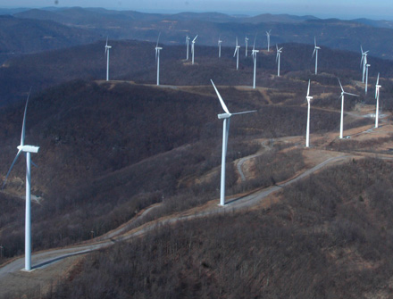
What do we know about KY’s wind potential?
3 years ago, data showed that KY had 34-60 MW of utility scale wind
New wind maps show 48,000 MW of utility scale wind (between 25% and 30% capacity factor at 100 meters)
Notes:
New wind data shows there is about 48,000 MW of wind potential between 25% and 30% capacity factor at 100 meters. We already talked about the many factors that go into determining “feasibility” – which comes down to cost. (Source: US Department of Energy)
Kentucky has some potential for large-scale wind generation. Previous surveys have measured at shorter turbine heights We need more information about our capacity at the new heights.
We have one advantage - Kentucky’s existing transmission line infrastructure gives our state an advantage in terms of wind development – building transmission lines to a site can often be 25% or more of the cost of a project. (Source: Personal interview, David Kinlock Brown)
Finally, let’s remember that every single one of Kentucky’s neighboring states has developed utility scale wind. Several of our neighbors have very good wind capacity, including Illinois, Indiana, West Virginia, Virginia, and North Carolina.

Slide 24

Russell Area Technology Center near Ashland
Dedicated in 2008, the 60-foot wind turbine is just one part of Russell ATC’s plan to reduce energy cost by 25% in one year
Notes:
In 2008, Russell Area Technology Center students and electrical technology instructor Doug Keaton gathered around a 60-foot tall, 1-kilowatt wind turbine to celebrate its opening operation. Using the turbine’s electricity is just one part of Russell ATC's larger plan to reduce energy costs by 25%. In 2009, students and teachers at Mason County ATC partnered on a similar venture, installing solar panels and a wind turbine at the school.

Slide 25
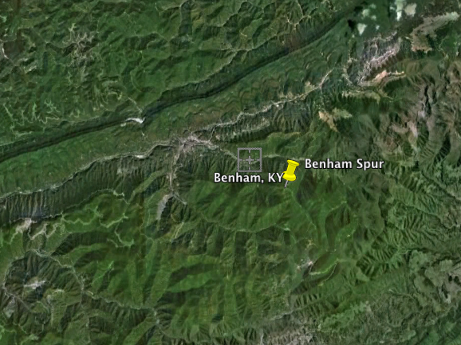
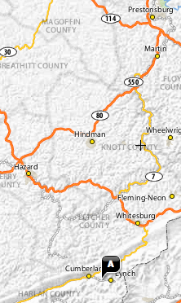
Kentucky’s Wind Resources
Benham Spur of Black Mtn
High potential site (2 MW)
Notes:
MIT scientists have measured the wind potential on Benham Spur to be 2 MW at a height of 80 meters. An illustration of what kind of potential is available.

Slide 26
Wind Power Investments
Create Jobs
  Ohio: 80,000 new jobs – 7,500 directly employed and the rest in wind manufacturing businesses
  Indiana: Nearly 400,000 job growth potential from existing and future wind power generation
Notes:
(source: Singh, Virinder. “The Work That Goes Into Renewable Energy.” Renewable Energy Policy Project, November 2001. Page 4.)
As you can see here, this chart compares the numbers of jobs and the lengths of time those jobs last between coal, wind and Solar pv. You can see that the wind and solar options create more and longer-lasting jobs than coal generation per $1 million of investment.
Wind industry jobs areas include manufacturing, engineering, construction, maintenance, and more. And small scale wind generation could be a source of income for Kentucky’s farmers.

Slide 27
Biomass Power
Kentucky’s Clean Energy Potential
Notes:
And finally, Biomass Power

Slide 28
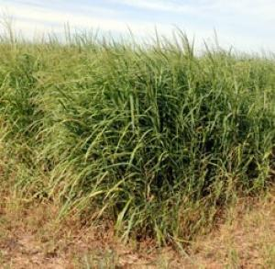
What can we say about biomass potential in KY?
KY has significant biomass and biofuels resources
There are ecological concerns
Notes:
The largest source of renewable energy in KY may be biomass, wood and other crops that can be burned to create electricity. Our state government is now aggressively pursuing the idea of burning wood and other fuel crops, along with coal, in our existing fleet of power plants.
Burning wood waste and switch grass in our coal-fired power plants could decrease the amount of coal used and lower Kentucky’s carbon dioxide emissions. And it could spur job creation and a stronger agricultural economy. However, a plan to use wood and crops for energy on this scale will have other important consequences for our forests, air, soils, and water. One paper suggests that growing fuel crops on a large scale could consume 13% of Kentucky’s existing farmland! These issues will need careful consideration from all of us in the near future.
Also, it’s important to note that burning biomass along with coal doesn’t help Kentucky make a transition to new energy sources; it just pushes the date of our transition further into the future.

Slide 29
There is broad consensus that…
Energy Efficiency is Kentucky’s cheapest, most abundant source of new energy
Kentucky has the opportunity over the next 20 years to significantly expand in-state renewable generation –especially hydro, wind, biomass, and solar
Diversifying our energy mix will reduce risk for KY’s ratepayers and utilities over the next 20 years
Notes:
There is a strong consensus emerging in Kentucky about the potential for efficiency and renewables to provide a rapidly increasing share of our overall energy portfolio. While there are still many important debates to be had, utilities, regulators, policy makers and consumers generally agree: *
Energy Efficiency is Kentucky’s cheapest, most abundant source of new energy. *
Kentucky has the opportunity to significantly expand in-state renewable generation, especially hydro, wind, biomass and solar in next 20 years. *
Diversifying our energy mix will reduce financial risk for KY’s ratepayers and utilities over next 20 years.
PAUSE FOR QUESTIONS!!! *

Slide 30
What are we doing well?
Net Metering
House Bill 1 (2007) and House Bill 2 (2008)
Government-Led Initiatives
Stimulus Funds
Notes:
Net metering allows folks who have a small renewable energy generator on their property – solar panels on their roof, for example – to sell back any excess energy they produce and receive a credit on their utility bills. This helps to increase the payback time for renewable installations.
House Bill 1, passed in 2007, created Corporate tax credits for large ‘alternative’ energy facilities and a Fund to invest in energy companies
House Bill 2, passed in 2008, created Tax credits for RE/EE: up to $500/personal and $1,000/business and state building standards for energy efficiency
And, we are doing some things right – we have opportunities to build from:
Government efforts – green schools, public building standards, new housing meeting energy star, KY Home Performance Program
Stimulus funds have also been used for a number of renewable energy and energy efficiency programs in Kentucky.
Local demonstration projects
Low-income weatherization
Green Bank of Kentucky, which funds green improvements to public buildings
Kentucky Home Performance Program, which funds part of the total cost of energy efficiency improvements on Kentuckians’ homes
$ for Kentucky Energy Efficiency Program for Schools (KEEPS)
Energy efficiency certification & training program at all local community & technical colleges in the state
Clean energy solutions on farms
And, we already have some “green jobs” in Kentucky. GE – located mainly in Louisville, is investing heavily in efficient appliances and now solar too. That is the biggest source of our green job growth of late in the state, according to a recent study.

Slide 31
What do we still need to do?
EKPC Collaborative
Local Organizing
Co-op Reform
PSC Reform
Advocacy with the Attorney General
Public Policy
HowSmart
Berea Solar Farm
Individual Action
Notes:
Policy solutions are just one method and KFTC is working on other solutions such as:
collaborative
Rural electric co-op reform
Community organizing: berea solar farm, lg&e rate case, Benham/lynch
Efforts to reform the Public Service Commission and the Attorney General’s office of ratepayer intervention to make them more receptive to clean energy solutions
Individual Kentuckians and businesses taking action to create distributed energy
Government efforts – green schools, public building standards, new housing meeting energy star
Stimulus momentum
Today, we’re going to describe to you some of the steps we need to take at the policy level to move build a clean energy market in Kentucky.

Slide 32
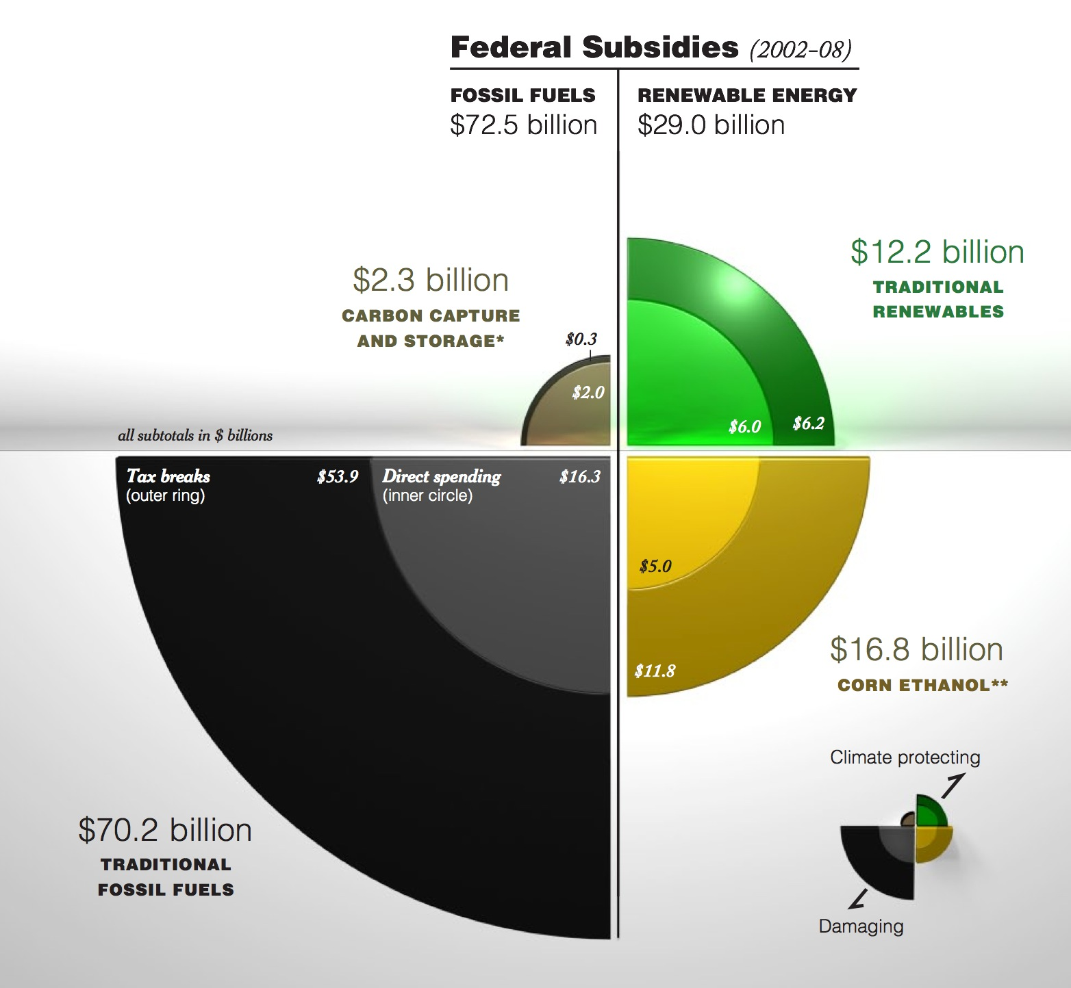
Why policy solutions?
Notes:
You can see the way that funding for energy is still heavily biased towards incentivizing the use of and development of fossil fuels. Changing policy can change this formula – that’s the kind of transition we need to see in this state and country to get where we need to go.
And, policy directs the markets which translate into job creation, as we’ve discussed.
Other states have reaped the benefits of good renewable energy and efficiency policies:
Indiana
Will have 398,000 MW of wind energy in coming years
Manufacturing potential could create over 25,000 jobs, $62.2 billion in investment
Nearly 400,000 jobs could be created from future wind power generation
Tennessee’s Volunteer State Solar Initiative
Over $2 billion in capital investment
1000 new jobs
2 new manufacturing plants in development
Ohio’s Booming Wind Industry
80,000 new jobs, primarily manufacturing
173 manufacturers actively supplying, with nearly 350 more on the way

Slide 33
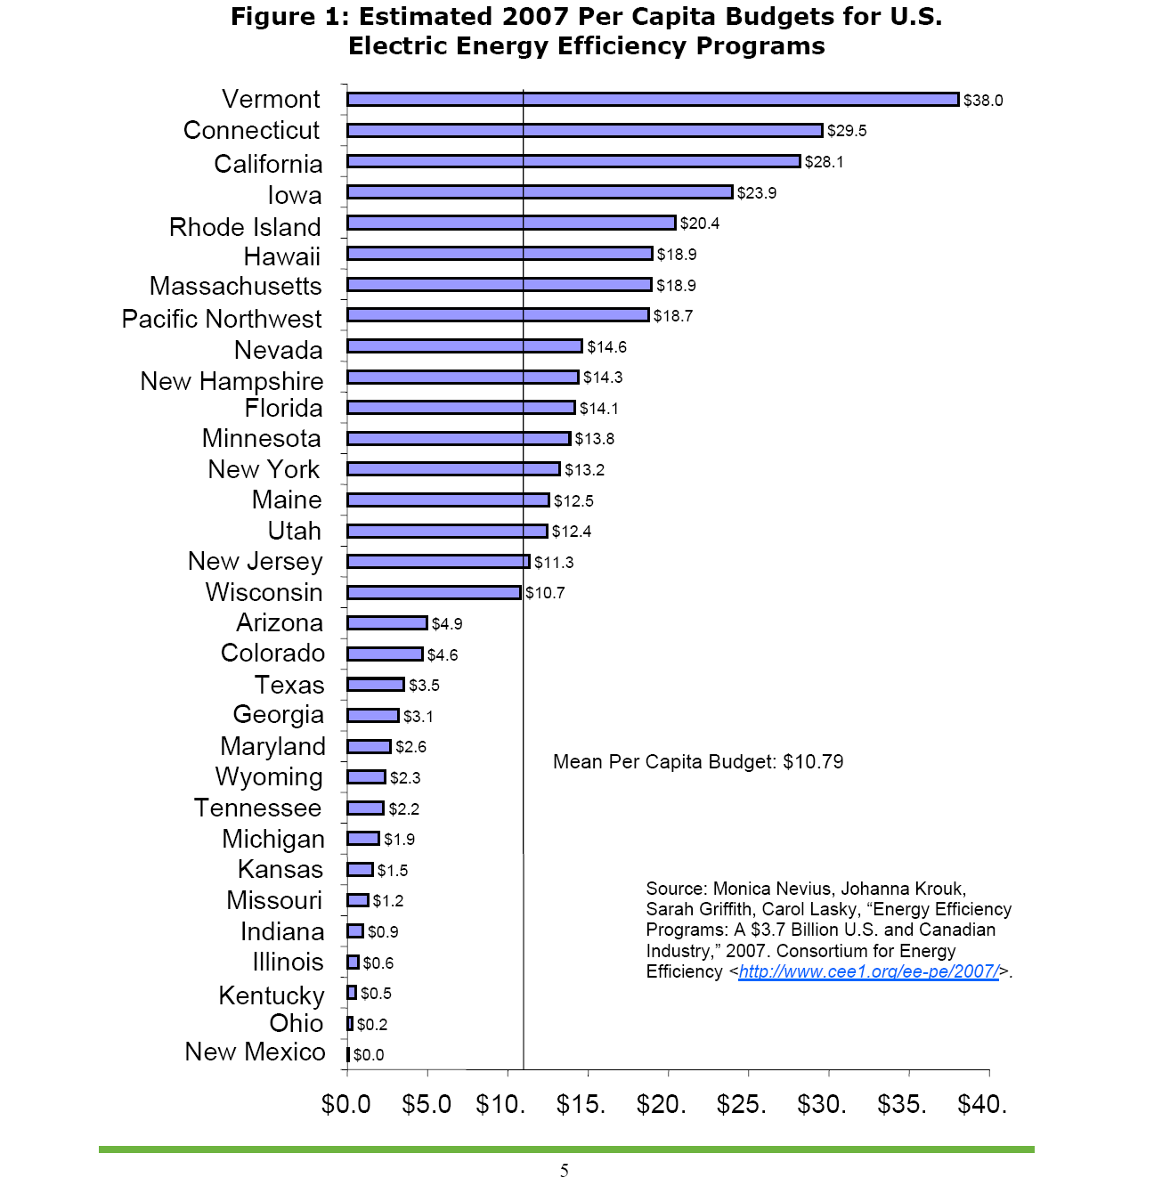
Invest in Energy Efficiency
In 2007, Kentucky spent just 50 cents per person on energy efficiency!
Notes:
Kentucky needs to invest in energy efficiency! *
In 2007, we spent just 50 cents per person on energy efficiency. But in 2008, House Bill 2 was passed in the KY legislature giving tax credits for energy efficiency improvements on residential, commercial, and state buildings. Our budget troubles, however, have put some of this work on hold. We really need legislation that helps homeowners pay for the up-front costs of improvements through loan programs or on-bill financing. *

Slide 34
Pass a Renewable and Efficiency Portfolio Standard (REPS)
Notes:
We also need to pass Renewable Energy Portfolio Standards, sometimes also called Renewable & Efficiency Portfolio Standards. These require utilities in the state to produce a certain percentage of their electricity from renewable energy sources and efficiency savings by a specified future date (or dates).
You can see that many of our neighboring states have some sort of REPS, including the coal states of Ohio, Pennsylvania, West Virginia, Virginia, and Illinois. Out of the 50 states, 37 have some form of REPS. Oklahoma recently set a goal of 15% of energy production from efficiencies and renewables by 2015. *

Slide 35
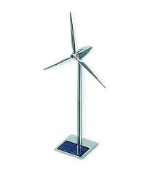

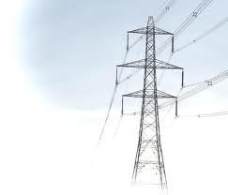


Establish Feed-In Tariffs
Hi, I’m Holly and I have a wind turbine on my farm.
Holly’s wind turbine generates more electricity than she can use. So, the extra electricity goes back into the grid.
Having guaranteed rates so I could know how much money I would earn made it all possible! Thanks KySEA!
Yah! We can buy this extra electricity from Holly to meet our REPS goal.
And, Holly says…
Utility company sends a check to Holly based on FIT rates for her wind energy
Utility Company Guy
Notes:
This is a basic explanation of how feed-in tariffs, also called CLEAN contracts (clean, local energy accessible now) work. Some key characteristics of them that have made them so successful in other states and countries are:
-long-term contracts
-guaranteed rates
-guaranteed purchase

Slide 36
What Can I Do?
Tell your legislator to support The Clean Energy Opportunity Act for a sustainable energy future for Kentucky and the growth of good jobs
Lobby in Frankfort for clean energy with KFTC
Present this PowerPoint to your church or community group
Get together with folks in your community to educate yourselves on these issues

Slide 37
It is time for Kentucky to transition to clean, affordable, and sustainable energy solutions
Create local jobs and grow Kentucky’s economy
Save money for Kentucky’s families, farms, and businesses
Improve Kentuckians’ health and environment
Build on Kentucky’s clean energy momentum
Notes:
It is past time for Kentucky to transition to clean, affordable, and sustainable energy solutions. If we can put these solutions in place, we can *
Create local jobs and grow Kentucky’s economy *
Save money for Kentucky’s families, farms, governments, and businesses *
Improve Kentuckians’ health and our environment *
Build on Kentucky’s clean energy momentum *

Slide 38

www.kysea.org
For more information, contact
Notes:
By working together we can develop the ideas, resources, public understanding and political support necessary to advance solutions that can help all Kentuckians save money and energy, especially those who are most vulnerable to rising costs and rapidly changing energy conditions.
And, opportunities exist. We’ve mentioned many today!
For more information, visit www.kysea.org.

