Slide 1
"Blue Ribbon" Tax Justice Web Workshop On your phone: 1-866-740-1260 Access Code: 8931147#
Notes:
Welcome!
This is KFTC’s Blue Ribbon Tax Justice Webinar. My name is Jessica Hays Lucas, and I’m KFTC’s Economic Justice Organizer.
Please make sure that you’re logged in. You should see KFTC’s logo. If you don’t, send an email to jessicabreen@kftc.org and I’ll send you the log in directions.
We’re likely going to put all the phone lines on mute as we move through the webinar to keep the noise level down. We’ll pause between every section for questions. If you want to mute yourself when I unmute the lines, just hit *6. You can unmute yourself with *7. You can also feel free to use the chat box that you see on the let of your screen. I’ll see your questions, but others won’t, just a heads up.
Let’s go!

Slide 2
Welcome!
Who We Are and Why We Care
Overview: Kentucky’s Tax and Budget Landscape
Opportunity: the Blue Ribbon Commission
A Framework
Our Role: Ways to Take Action
Notes:
This is our agenda for the next hour. We’ll do a quick overview of Kentucky’s tax and budget landscape. Then we’ll take a look at the role that the Blue Ribbon Commission is playing, and the significance of their work over the next several months. Next we’ll go through some of the Commission’s current conversation, as well as some perspectives that they need to hear more about. Finally, we’ll offer some ways to take action, as well as some tools to help frame up messages that we can all build from.

Slide 3
Why We Care
Notes:
These are squares from a quilt that young KFTC member contributed to at our 30th Anniversary party last year. They were asked to draw a square that represented their vision for Kentucky.
They made squares about healthy jobs, healthy earth, and healthy food. Their family and friends, happy and healthy. Their homeplace. Good public education and clean air. Good, healthy growth.
We know what we want, and we know that we’re worth the investments for good jobs, clean air and water, quality educations, and healthy, vibrant communities. This Kentucky is possible, but we need to reform our state taxes. We believe that Kentucky hasn’t met its potential just yet, and that tax reform is a necessary piece of getting us there.

Slide 4
Key functions of Kentucky’s state budget
Notes:
…Because state taxes make a lot of things possible. The things that are too big to do as individuals, we do through our government. These are all the things that our state General Fund handles. Education. Text books, after-school programs. Higher ed. Public safety and the justice system. Public health, and food inspections, and (in theory) monitoring our water so we know it’s safe. Meals on Wheels. When we don’t have adequate revenue, al; these things suffer, and our quality of life goes down.

Slide 5
Long-Term Sustainability
Source: Kentucky Center for Economic Policy
Notes:
While the recession has exacerbated our revenue shortages, our revenue shortfall is not simply a function of the recession. What we want is a a revenue stream that keeps pace with the economy. This graph from KCEP shows that our revenue stream is *not* keeping pace with the economy. The economy’s been bad, but our revenues still haven’t kept up with it. The resulting trend is that the gap between what we have and what we need is getting wider every year.

Slide 6
Cuts to Selected Agencies, 2008-2013
 | State funding change (inflation-adjusted)
Kentucky Arts Council | -38%
Kentucky Educational Television | -34%
Libraries | -30%
Public health departments | -29%
Environmental Protection | -27%
Workforce development | -25%
Nature Preserves Commission | -22%
Vocational Rehabilitation | -21%
Public universities & community colleges | -21%
Source: Budgets of the Commonwealth
Notes:
As a result, some of the necessary functions of our state government—higher ed, public health, environmental protection—have faced substantial cuts over the last 4 years. Before that, there was a decade of budget cuts. We’re in a pretty hard place right now.

Slide 7
Libraries cut 30% since ‘08
"My family is at our library at least once a week to keep current on our reading and to introduce our 3-year old and our 8-month old to the world of books. It seemed like my local library always had a shelf full of new books on display. Now I only see a handful.” – Carter Wright, Jefferson County member
Notes:
Let’s look at libraries because they sometimes get overlooked. We can cut libraries and keep on ticking, if we want to. But let’s look at this example for that reason.
Carter Wright’s quote speaks to one way in which cuts to libraries, while not fatal, impact the quality of life in Kentucky. And, libraries are also a crucial way for people get affordable access to information. Most job postings are online now. Resources for studying for the GED. For people who can't afford home Internet, the library is the best way to apply for jobs. Cutting back on services and hours makes it even harder for Kentuckians to get back on their feet. There are lots of ripple effects even to cuts to libraries.
These cuts cost services that we all depend on, and jobs that many of us depend on. Here in Fayette County, 25 of our health office workers are facing losing their jobs because of those state and federal budget cuts. School nurses are also on the way out here in Fayette County. And this is after the office in my own neighborhood closed down last summer because of budget cuts .
These cuts to necessary functions of state government impact stretch the capacities of both Kentucky’s public sector and non-profit sector. Non-profits and churches can only do so much to take up the slack. The cracks are inevitable, and people deserve better.

Slide 8
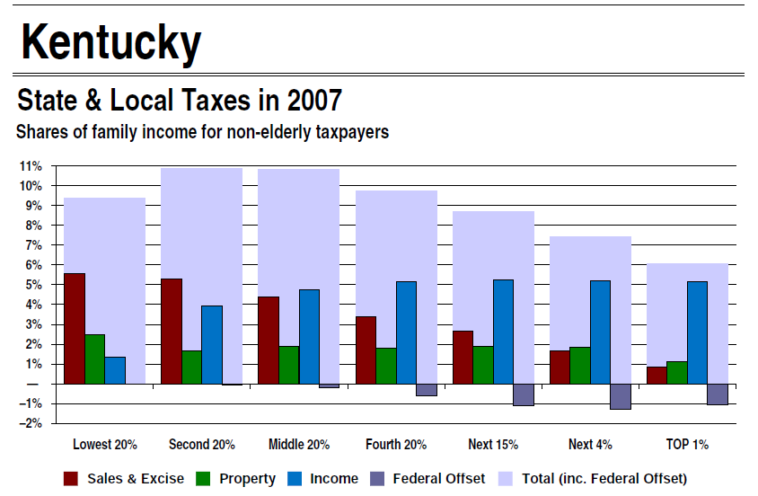
Tax Fairness
Source: Institute on Taxation and Economic Policy
Notes:
And it’s the same people—Kentucky’s low- and moderate-income families—who are disproportionately impacted by our state taxes.
Further, because of our tax structure, the people that so many of us are trying to help step up are being disproportionately impacted by our tax structure. What you’re looking at: This is how our state and local taxes impact KY families across the income levels.
Focus first on the light blue bars. They represent how our state and local taxes impact families across the quintiles, which is to say, Kentucky’s income earners divided into groups of 20%. The first bar represents the lowest 20% of income earners, the second is the next 20%, and so forth. The highest 20% of KY’s income earners, though, is divided up, so that the top 1% and the top 5% is pulled out from the other 15%. That’s because the income range is so vast for that top 20%.
What this graph shows is that low- and middle-income Kentuckians pay about 11% of their income to state and local taxes, while the state’s wealthiest 1% pay about 6% of their income to state and local taxes. This kind of impact—where the lower income folks are disproportionately impacted—is called a regressive system.
Now, the other thing that this graph shows is the components of our tax structure that make our overall system regressive. The colored bars within the blue bars who the impact of our sales tax, our property taxes, and our income taxes. If you focus on the red bars, the sales tax, you can see just how regressive the sales tax is. Low-income folks pay about 5.5% of their total income in sales taxes, while the wealthiest 1% don’t even pay 1% of their income in sales taxes. This is why a system like TN’s, which is almost entirely dependent on sales taxes, would be so harmful to most Kentuckians.
One final point about this graph: The income tax is imperative in mitigating the regressive impact of our sales tax. To make our system fair—so that everyone is contributing their fair share--we’ll need to make our income taxes more progressive, so that higher income is taxed at a higher rate, and the taxes paid by lower-income folks are reduced.

Slide 9
Notes:
So now, Kentucky is at a crossroads. We’ve—KFTC members and allies, the state legislature, elected leaders—we’ve known about these problems with our state tax structure since at least 2001. And Kentuckians surely have been feeling the impact of closing health offices, more students in the classroom and outdated textbooks, fewer safeguards that catch people who stumble, and a quality of life that’s slipped behind the rest of the nation. We can continue to do nothing, but that would mean continuing to not do right by our families, communities, and commonwealth, and that future is bleak.
The challenge has been in creating the political will to make the necessary changes. This is why we are excited about the Blue Ribbon Commission’s work. This is our best chance in decades to deal with some of the problems that have been crippling Kentucky along our way forward.
We’ve covered the overview of Kentucky’s tax and budget landscape. Are there any questions so far?

Slide 10
Blue Ribbon Commission
Purpose
Process
Principles / guidelines / goals
Conversations
Notes:
Now, we’re going to spend a little time going over the Blue Ribbon Commission—its purpose, its principles or guidelines, and its process.
In January, Governor Beshear announced a Blue Ribbon Commission on Tax Reform, to be led by the Lt. Gov. The Commission is charged with studying and recommending to our state legislature tax reforms that raise revenue. Starting on May 29, the Commission will be holding Public Meetings in each of Kentucky’s
six Congressional districts, where the public is invited to come share their best ideas and thoughts about needed state tax reforms. The Commission will be drawing from these public forums as it develops a set of tax reform recommendations for the 2013 General Assembly.

Slide 11
Blue Ribbon Commission’s Process
Notes:
This is what the Commission’s plan is. Some of us have been going to the three “boot camp” meetings, and we’ll share the conversations we’ve heard at those in the next little bit. Orientation “boot camp,” then some public input meetings, then meetings to debrief with economists, then recommendations come out.

Slide 12
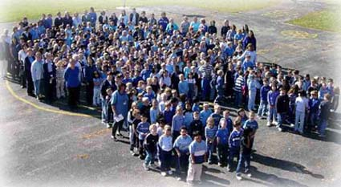
Commission’s Timeline
Notes:
From our perspective, the Big Deal is going to be the Public Input Meetings, from May to August. This is where we need to be participating, and getting all our friends and neighbors and networks to participate. We want the Commissioners to be able to say that they heard Kentuckians going to bat for everyone paying their fair share of taxes, for revenue that is adequate, and for a good solid infrastructure that we can all depend on. As one of us said recently, “If we’re not there, who will be?”

Slide 13
Blue Ribbon Commission
Purpose
Process
Principles / guidelines / goals
Fairness -- Simplicity and Compliance
Competitiveness -- Elasticity
Adequacy
Conversations
Notes:
The Commission’s mandate is to study and build consensus around a set of not just any old policy solutions, but policy solutions with specific goals and guidelines: fairness, competitiveness, simplicity and compliance, elasticity and adequacy. These are not incongruent with The Partnership’s principles of tax reform: fairness, adequacy, sustainability, and supportive of the well-being of Kentuckians.

Slide 14
The Blue Ribbon Commission is having some key conversations…
Notes:
These are some of the conversations that have threaded through the last three Blue Ribbon Commission meetings.
They want to know what Kentuckians want. The Commissioners do seem, on the whole, interested in really hearing from Kentuckians. What *do* Kentuckians want? What do people say about taxes as they’re settling in for a hair cut at the local barber shop? This is a good start.
What can we do with our sales and income taxes? The Commissioners aren’t just about rhetoric. They’re willing to dig in to see what changes people want. Do we want to throw out our income taxes? Do we want to increase the sales tax? Can we apply the sales tax to more things? All these conversations have implications for how our tax structure impacts families. It is possible for the Commission to make things worse. But it’s also a good opportunity for us to chart out how they can make things better.
How can we welcome businesses to Kentucky? This seems to be the dominant frame. Unfortunately, a chunk of this conversation is about how low can we go with corporate tax rates. Attracting and growing jobs for Kentucky workers is a good starting place, but we want expand the conversation to include really making Kentucky a competitive contender for jobs because our infrastructure is rock-solid and and our people are skilled, innovative, and hard-working.

Slide 15
But these important conversations are missing…
Notes:
While the Commission’s been having those important conversations, they’ve also been missing some important conversations. It will be up to those of us on this call, and our networks, and the people who come to these public input meetings to fill in the blanks.
What *are* Kentucky’s budget needs? Strangely, the Commission has *not* discussed the impact of the years of chronic underfunding of necessary functions of our state government, nor have they addressed the impact of the budget cuts over the last 4 years. Nor have they asked themselves the question, “What kind of Kentucky do we want, and how can we meet those investments?” This—envisioning a commonwealth that meets our people’s enormous potential—will be our work to do.
What’s the impact of Kentucky’s tax structure on Kentuckians of various incomes? What’s the impact on low- and moderate-income Kentuckians? The chart is the same chart that we saw earlier. An outdated version of it was included in one of the Commission’s presentations, but it just got a light touch. For the Commission’s work to improve our current situation, the impact of our taxes on low- and moderate-income Kentuckians, and how Kentucky’s tax structure is exacerbating the wealth gap, needs to be much more of a focus. This will be some of our work to do.
What does it really mean to make Kentucky a “competitive” state? While the Commission’s talked about not wanting to drive away industry, this is an opportunity to orient ourselves toward a vision of what Kentucky can be, and the kind of jobs that we can create and grow. We all want Kentucky to be competitive, but that means much more than just low tax rates for industries. Being a competitive state means investing in a rock-solid infrastructure and a healthy, skilled, innovative and educated workforce. As one KFTC member puts it, “I want people to want to hire my children because they are well-educated and skilled. Not because they’re cheap.”
So that’s the Commission. Let’s pause for questions.

Slide 16
What’s our role?
Some things to lift up:
Support for a fair structure, where everyone pays their fair share.
Support for adequacy.
Competitiveness via fairness and adequacy.
Specific policy solutions.
Notes:
That’s the Commission. Now let’s turn back to ourselves. Given this tax and budget landscape, and given this work from the Commission so far, what’s our role? How can we best focus our efforts over the next 3 to 6 months? We’ve got significant needs, but these are also significant opportunities.
In many ways, we know what we need—or have the opportunity—to do. We need to lift up:
The need for fairness to lower-income Kentuckians
The potential of our commonwealth, with adequate investments in the public sector, and in our people.
This expanded perspective on competitiveness. If we have taxes that help people instead of hinder them, and that invest in our good people here in Kentucky instead of cutting our best efforts off at the knees, we’ll be a more competitive state.
Specific policy solutions, even broadly.

Slide 17
Policy solutions include…
Notes:
These are some of the possible policy solutions, broadly, that could be lifted up in these public meetings. We know the importance of the income tax in making our overall structure fairer. Let’s speak to that, broadly.
We know that corporations benefit from the same rock-solid infrastructure that we all benefit from as individuals, so let’s make sure that they’re paying their share, too. Twenty-four other states have combined reporting, which stops large corporations from hiding taxable income in states where it can't be taxed.
Kentucky has rarely met a tax subsidy it didn’t like, especially for the coal industry. But some of these subsidies don’t translate to good job growth. We could put in place sunsetting and reviewing tax expenditures. Require that tax expenditures expire every 5-10 years and be evaluated prior to expiration, putting them on a more even playing field relative to the state budget and bringing greater accountability to what we spend through the tax code. And combined reporting is something that twenty-four other states have to stop large corporations from hiding taxable income in states where it can't be taxed. Just good common sense.
And the commissioners need to hear that people don’t want Kentucky to make the loopholes bigger; instead, we want to make the loopholes smaller.
Sales tax. Our sales tax is about 60 years old and its showing its age. Kentucky doesn’t tax some of the same services, particularly the luxury services, that are taxed in all our surrounding states.
Finally, we know that lower- and moderate-income Kentuckians are struggling, and that a state EITC would help make our taxes more fair. And a healthy one, like the one in our Kentucky Forward bill, would help reduce poverty.
These are some of the things that are aligned with the Commission’s guidelines, with the Partnership’s principles, and with conversations that the Commission’s been having up to this point. These four things would help move the Commission toward our principles, and away from some bad choices.

Slide 18
Tools
A shared framework
Opportunities to share it and ways to take action.
Resources to learn more.
An invitation to continuing to network with each other.
Notes:
They say that you could save a city with a good pocket knife. We’re hoping we can make good improvements to the commonwealth with a few simple tools that we can all use during these public meetings. We’ll go through each of these, some more briefly than others.
We’ll introduce a tool that we can all use—a shared framework--and some places and ways to use it to start shaping and informing the work and the recommendations of the Blue Ribbon Commission. And we’ll offer ways to stay and touch and keep learning from each other.

Slide 19
Elements of our unified message
Personal
Grounded in the Commission’s own guidelines
Solution-oriented
Echoed by others/Echoing others
Notes:
Let’s think about a shared framework. A framework isn’t a script, but its something that you can hang your story within. It helps us all say own own message, while also echoing a larger common message. Why? Because while we all want to show up at these meetings with our own voice and our own stories, we can make a bigger impact if we carry a common message. We don’t want to say the same lines, but we want to build off each other.
So for our purposes, we want a shared framework that lets us be personal, grounded in the Commission’s own guildelines, and solution-oriented. Our own stories, in that framework, will help make it easier for the commissioners to remember our message, and carry it forward.
(Thanks to the KY Council of Churches for this adorable photo.)

Slide 20
A Possible Framework
I. The essentials: Who you are and the Kentucky you want to see.
II. The tax- and revenue-related obstacles standing in our way
III. Good solutions
Notes:
So we tried to develop something that did all those things.
This is one possible framework for how we might all develop our messages to the Blue Ribbon Commission. It’s not a prescription, but it will give our messages a sense of cohesion.
It starts with the essentials—who you are and what you want to see for Kentucky. Then it acknowledges the obstacle of our outdated tax and revenue system. Finally, it points toward good solutions. The helpful part, too, is that if someone can’t make it all the way through, he’ll still be building on the others in the room who can make it all the way through. We’ve tried to weave our message throughout. Let’s dive in…

Slide 21
I. The essentials
I am _____.
I want to see ____.
“I’m another Kentuckian for raising revenue, and for everyone paying their fair share toward making Kentucky a great place to live and work."
Notes:
Take some good time to describe yourself. I am a mom. I am from a family of farmers and teachers, with grandparents who’ve worked hard right here in Kentucky all their lives. I am still looking for work, or I am friends with lots of people still looking for work. I am someone who drinks tap water. Choose something and go with it. If you need to do 5 different versions, do it.
Then, transition to what you want to see for Kentucky. I want every child in Kentucky to have a good school librarian. I want every grandparent to have plenty of good food to eat every day. I want to see Kentucky invest in clean energy jobs, in the jobs that depend on our skill and innovation. Take some time describing what you want to see.
Here’s a suggestion. Really commit to describing this vision for Kentucky. From what the Commissioners have said already, if people go in there with a request for more funding for X, Y, or Z, that request isn’t likely to be heeded, valid though it may be. So take some space to lift up a vision for Kentucky that depends on growing the pie.
Finally, there’s the hook. Something along these lines: I’m another Kentuckian for raising revenue and for everyone paying their fair share toward making Kentucky a great place to live and a great place to work. Something along these lines. Then, if that’s all you can do, or all that your neighbor can do, you can stop there and you’re good.

Slide 22
II. What’s in the way
Lack of fairness.
Our current taxes are not fair because low- and middle-income Kentuckians pay about 11% of their income in state and local taxes, while the wealthiest pay about 6%. This isn’t fair.
And/ or
Lack of adequate revenue.
Our current tax structure is inadequate. [Reference some of the budget cuts that are impacting your community.]
And/ or
Lack of investments to support good jobs and help KY stay competitive.
We can be a more competitive state for good jobs if we invested more in our people, and stopped cutting budgets and public sector jobs.
Notes:
Then, if you can, move to what’s standing in our way. The vision that you laid out is likely to be one that most people can get behind. So why aren’t we there? What’s standing in our way? Probably a few things, but they most certainly include the problems with our tax and revenue structure.
This phase is divided up according to the three principles, or guidelines, that the Commission is working within. Fairness. Adequacy. Competitiveness. You can take up all three of these, or you can choose from them, going into a little more depth.

Slide 23
III. Good solutions
Good solutions include:
1) A more progressive income tax, with a state EITC, to ensure that we're all paying our fair share.
2) Taxing the same luxury services that our surrounding states tax.
3) Closing corporate tax loopholes.
Good tax reforms must raise revenue, be fair to lower- and moderate-income Kentuckians, and allow sustainable investments in Kentucky’s future. Thank you.
Notes:
Finally, we want to offer some good policy solutions. The ones that we’ve included here are the ones that are in alignment with our Partnership principles. They aren’t the only possible solutions, but they’re biggies.

Slide 24
A Possible Framework
I. The essentials: Who you are and the Kentucky you want to see.
II. The tax- and revenue-related obstacles standing in our way
III. Good solutions
Notes:
So altogether, a statement could read something like this:
My name is Jessica Hays and I began to love reading when my school librarian read us Jack Tales during library class in the 4th grade. She played a big role in helping me want to learn about Kentucky and Appalachia and other stories and books. I want my son, and all Kentucky children, to be exposed to things that help them love learning and love reading.
But his school librarian was laid off last year because of budget cuts, and his class size is getting bigger every year. I think that’s a shame, and that our kids deserve better. So I’m another Kentuckian here in support of raising revenue. I’m for everyone paying their fair share toward making Kentucky a great place to live and work.
Here are three good solutions: 1) a more progressive income tax that lets the wealthiest pay their fair share,2) taxing more services to keep up with the economy and 3) making sure that we close the loopholes for corporations. Good tax reforms must raise revenue, let everyone chip in equitably, and allow for good investments so that every Kentucky kid has a first rate education.
Questions and comments? Or in case someone has a statement they’d like to share?
So then the question is, where do we say all this stuff?

Slide 25
Take Action: Come to the Meetings!
Tuesday, May 29, 6 p.m., Paducah
Tuesday June 19, 6 p.m., Bowling Green
Tuesday July 10, 6 p.m., Louisville
Tuesday July 24, 6 p.m., Covington
Tuesday Aug 7, 6 p.m., Prestonsburg
Tuesday Aug 21, 6 p.m., Lexington
Notes:
Of course we should come to these meetings! Come to the one nearest you, and bring your friends, your family, your co-workers, the people you work with.
Let them know that you’re coming, and let KFTC know that you’re coming. We’d love to coordinate with you, and make sure that everyone feels supported and has a ride. You can either let us know on our Blue Ribbon page or by talking with your organizer or me.

Slide 26
Take Action: on the web!
Comment on the Blue Ribbon Commission website.
Share out the facebook events to help get the word out.
Notes:
If you can’t come to the meeting—even if you can—share your comments with the Blue Ribbon Commission online. Just go to the Lt. Governor’s site, and you’ll find the link under “Tax Commission.” Get your friends to comment, too!
And you’ll notice that the organizations in the Partnership are starting to set up facebook events for these public meetings. Please find them—searching for Blue Ribbon Commission and the city should do it—and share them out widely. It might be a good place to model and practice your statements, and might help others become more confident in delivering their statement, too.

Slide 27
Take Action: Talk with your friends and family!
Notes:
If you’re a New Power Leader, or have some friends and family who don’t know much about taxes and budgets, yet, bring them into the conversation. Invite them to come to this meeting with you, share your statement with them, and help them think about what they want to say. We need lots of voices here, so bring the ones that you’d want to hear.
Thank you for participating!

Slide 28
Take Action: Write Letters!
Help create good local conversations by submitting your statement as letters to the editor, especially for the two weeks leading up to your local event
Meet with your local paper’s reporters and/or editorial board/editor.
Notes:
And if you ended up writing four different versions of your statement—because we all wear a lot of hats—consider making one a letter to the editor. Submitting these letters before the event, along with an invitation to come on out, will help create good local conversations and reference points leading up to the public meetings.
Want to do more? Meet with your local paper’s reporters and/or editorial board/editor. Talk with them about covering the local event and offer yourself as a source for a local voice.

Slide 29
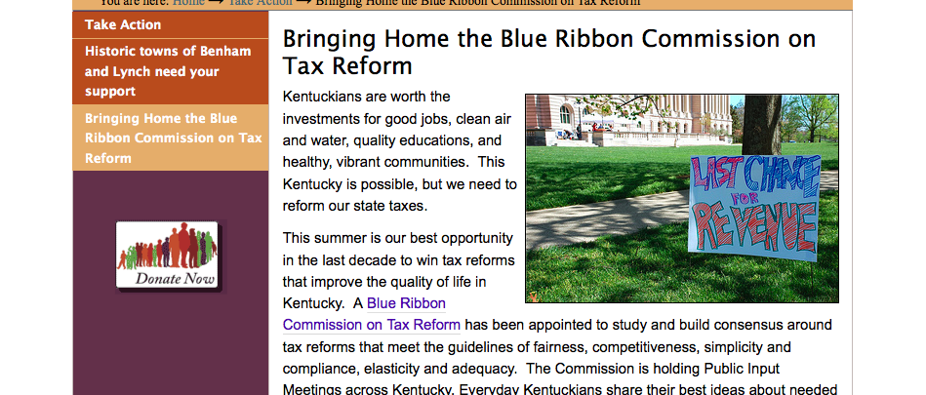
Go to KFTC’s Blue Ribbon Commission page!
www.kftc.org/Blue-Ribbon
Sign up to speak
Sign up to coordinate
Work with the framework we used tonight.
Find a tax policy talking point sheet that you can print out and bring to the meeting.
Times and places of all the meetings.
Notes:
Go here, right now, in another tab. You can go to our home page and hit the big blue ribbon on the right. This is where our action toolkit lives.
Before you do anything else, click the button to sign up to speak. We want to make sure your voice is heard.
Now, you’ll also find the link (#2) to submit comments online. Please do that!
Finally, you’ll see the framework that we’ve worked with, as well as a policy talking points sheet that you can download and print out and bring with you to the meeting, if you want to talk more or learn more about any of the policies that we’ve talked about tonight.
Thank you for joining this webinar! I hope it was useful, and am excited to see many of you in the little bit at these meetings. My number is 859.533.0613 if you should have any questions, and my email address is jessicabreen@kftc.org. I’d love to hear from you!

